Slide 1
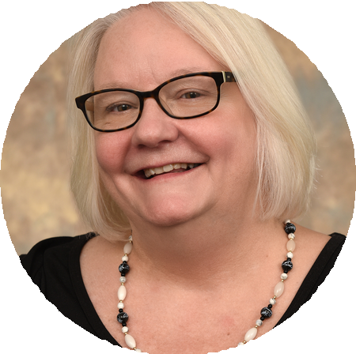
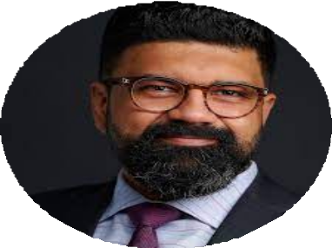
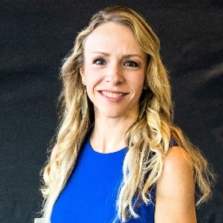
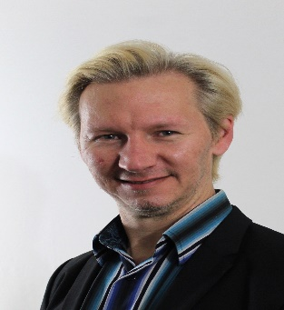
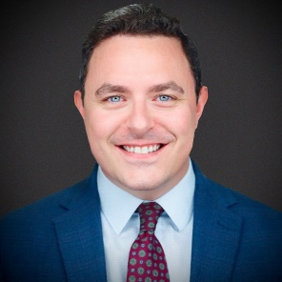
2023 ASCLS-IL Annual Meeting #Labtoberfest
Confirmed Speakers

Slide 2
Continuing Education provided by P.A.C.E.
CONTINUING EDUCATION SESSIONS CONTINUING EDUCATION SESSIONS
Saturday, October 14th 9:00 a.m. - 3:45 p.m.
ASCLS-IL is an approved provider of continuing education by the P.A.C.E.® Program. One contact hour is equal to one P.A.C.E.® credit. All sessions will be P.A.C.E.® approved. Attendees are able to download the CE certification from the website www.ascls.org via the CE Organizer. The CE code will be provided at the end of each session and need to be claimed by November 28, 2023.

